Slide 1
Discrete Mathematical Chapter 2

Slide 2
Predicates and Quantifiers

Slide 3
Terminology review
Proposition: a statement that is either true or false
Must always be one or the other!
Example: “The sky is red”
Not a proposition: x + 3 > 4
Boolean variable: A variable (usually p, q, r, etc.) that represents a proposition

Slide 4
Propositional functions
Consider P(x) = x < 5
P(x) has no truth values (x is not given a value)
P(1) is true
The proposition 1<5 is true
P(10) is false
The proposition 10<5 is false
Thus, P(x) will create a proposition when given a value

Slide 5
Propositional functions
Let P(x) = “x is a multiple of 5”
For what values of x is P(x) true?
Let P(x) = x+1 > x
For what values of x is P(x) true?
Let P(x) = x + 3
For what values of x is P(x) true?

Slide 6
Anatomy of a propositional function
P(x) = x + 5 > x
predicate
variable

Slide 7
Propositional functions 3
Functions with multiple variables:
P(x,y) = x + y == 0
P(1,2) is false, P(1,-1) is true
P(x,y,z) = x + y == z
P(3,4,5) is false, P(1,2,3) is true
P(x₁,x₂,x₃ … x_{n}) = …

Slide 8
So, why do we care about quantifiers?
Many things (in this course and beyond) are specified using quantifiers
In some cases, it’s a more accurate way to describe things than Boolean propositions

Slide 9
Quantifiers
A quantifier is “an operator that limits the variables of a proposition”
Two types:
Universal
Existential

Slide 10
Universal quantifiers
Represented by an upside-down A: ∀
It means “for all”
Let P(x) = x+1 > x
We can state the following:
∀x P(x)
English translation: “for all values of x, P(x) is true”
English translation: “for all values of x, x+1>x is true”

Slide 11
Universal quantifiers
But is that always true?
∀x P(x)
Let x = the character ‘a’
Is ‘a’+1 > ‘a’?
Let x = the state of Virginia
Is Virginia+1 > Virginia?
You need to specify your universe!
What values x can represent
Called the “domain” or “universe of discourse”

Slide 12
Universal quantifiers
Let the universe be the real numbers.
Then, ∀x P(x) is true
Let P(x) = x/2 < x
Not true for the negative numbers!
Thus, ∀x P(x) is false
When the domain is all the real numbers
In order to prove that a universal quantification is true, it must be shown for ALL cases
In order to prove that a universal quantification is false, it must be shown to be false for only ONE case

Slide 13
Existential quantification
Represented by an backwards E: ∃
It means “there exists”
Let P(x) = x+1 > x
We can state the following:
∃x P(x)
English translation: “there exists (a value of) x such that P(x) is true”
English translation: “for at least one value of x, x+1>x is true”

Slide 14
Existential quantification 2
Note that you still have to specify your universe
If the universe we are talking about is all the states in the US, then ∃x P(x) is not true
Let P(x) = x+1 < x
There is no numerical value x for which x+1<x
Thus, ∃x P(x) is false

Slide 15
Existential quantification 3
Let P(x) = x+1 > x
There is a numerical value for which x+1>x
In fact, it’s true for all of the values of x!
Thus, ∃x P(x) is true
In order to show an existential quantification is true, you only have to find ONE value
In order to show an existential quantification is false, you have to show it’s false for ALL values

Slide 16
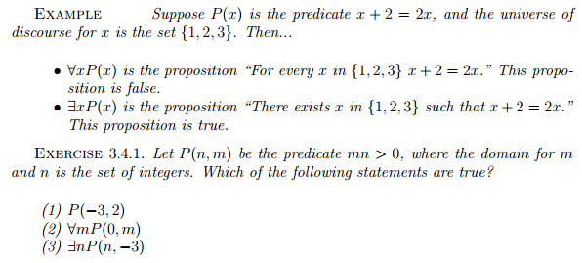
Examples

Slide 17
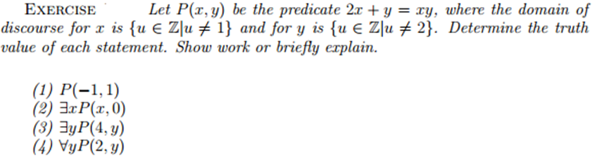

Slide 18
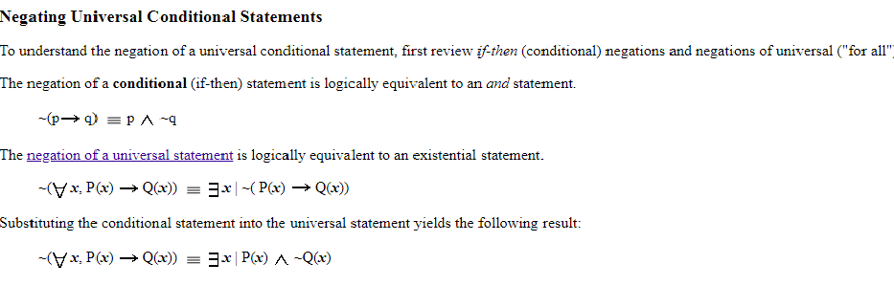

Slide 19
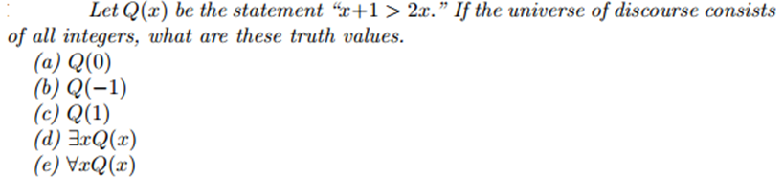
Example

Slide 20
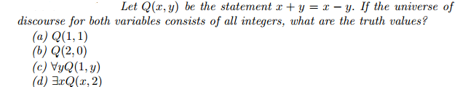

Example

